Slide 1
NHD: A Topology-Aware Kubernetes Scheduler
Cliff Burdick
Viasat
November 20, 2019

Slide 2
Agenda
01
Terminology
04
Challenges With HPC/NFV Software In Kubernetes
02
HPC/NFV Requirements
05
NHD: A New Topology-Aware Scheduler
03
What Is Topology Awareness?
06
Future Work

Slide 3
Similar Talks
Is There a Place for Performance Sensitive Workloads in Kubernetes?
Today, • 3:20pm - 3:55pm (Room 15AB)
Gergely Csatari & Levente Kale, Nokia
Mitigating Noisy Neighbours: Advanced Container Resource Management
Today, • 3:20pm - 3:55pm (Room 28ABCDE)
Alexander Kanevskiy, Intel
Running High-performance User-space Packet Processing Apps in Kubernetes
Tomorrow, November 21 • 2:25pm - 3:00pm (Room 5AB)
Abdul Halim, Intel & Peng Liu, Red Hat
RDMA Enabled Kubernetes for High Performance Computing
Tomorrow, November 21 • 4:25pm - 5:00pm (Room 33ABC)
Jacob Anders, CSIRO & Feng Pan, Red Hat

Slide 4

Terminology
HPC (High Performance Computing)
Software that performs calculations at a high speed on dense servers
Typically uses accelerator cards
NFV (Network Function Virtualization)
Virtualizing network functions in software
NUMA
Non-Uniform Memory Access
RDMA
Remote DMA – Transferring data directly from NIC to other device

Slide 5

HPC/NFV Requirements
High Network Throughput
40-100 Gbps Interfaces
Multiple interfaces
Tens of millions of packets per second
Low Latency
< 10us packet processing time
SmartNICs
HW offloads
SR-IOV
Accelerator cards
GPUs, FPGAs, TPUs, etc

Slide 6
What’s Needed?
Userspace networking
DPDK
Isolated CPUs
NUMA-Awareness
Both memory and devices
RDMA
Used to transfer data directly from NIC to other devices
Hugepages
Larger page sizes for fewer TLB misses
All of these require some level of topology awareness!

Slide 7

DPDK
Userspace packet processing framework
Completely bypasses kernel
Most of the time
Polling-based
Dozens of poll mode drivers (PMDs)
Allows users to change hardware without modifying the software
Provides NUMA-aware high-performance libraries
Inter-thread communication
Memory allocator
Crypto
Foundation of many high-speed packet processing libraries

Slide 8
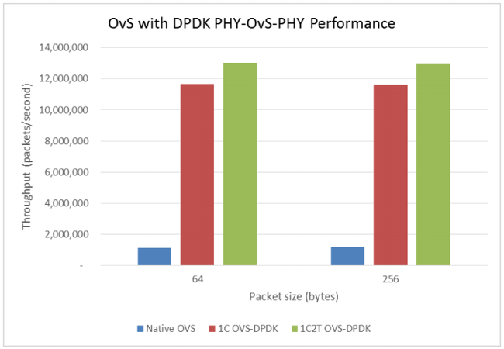
DPDK Performance

Slide 9
What does it mean to be topology-aware?

Slide 10
Scheduling A Pod
1) Ready For Scheduling
2) Find Resources
(CPU, memory, disk)
3) Schedule Pod

Slide 11
Single Socket, No Hyperthreading
Intel Xeon
Core
0
L
1
L
2
Core
1
L
1
L
2
•••
Core
19
L
1
L
2
L3 Cache
80GB/s
DDR
IO, PCIe, etc
Graphics
DDR Controller

Slide 12
Single Socket, Hyperthreading
Intel Xeon
Core
0
L
1
L
2
Core
1
L
1
L
2
Core
19
L
1
L
2
•••
Core
20
Core
21
Core
39
L3 Cache
80GB/s
DDR
IO, PCIe, etc
Graphics
DDR Controller

Slide 13
Dual Socket, Hyperthreading
Intel Xeon
Intel Xeon
Core
0
L
1
L
2
Core
1
L
1
L
2
Core
19
L
1
L
2
Core
0
L
1
L
2
Core
1
L
1
L
2
Core
19
L
1
L
2
•••
•••
Core
20
Core
21
Core
39
Core
20
Core
21
Core
39
L3 Cache
L3 Cache
IO, PCIe, etc
Graphics
DDR Controller
IO, PCIe, etc
Graphics
DDR Controller
80GB/s
80GB/s
UPI
35GB/s

Slide 14
GPU + NIC
12.5GB/s
12.5GB/s
35GB/s

Slide 15
Single-Root PCIe
12.5GB/s
12.5GB/s
35GB/s

Slide 16
GPU + NIC + PCIe Switches
12.5GB/s
12.5GB/s
12.5GB/s
12.5GB/s
35GB/s

Slide 17
GPU + NIC + PCIe Switches
12.5GB/s
12.5GB/s
12.5GB/s
35GB/s

Slide 18
Network

Slide 19
Kubernetes Challenges
Isolating Cores
CPU Selection
NIC/Interface Sharing

Slide 20
Kubernetes Challenges
Isolating Cores
CPU Selection
NIC/Interface Sharing

Slide 21

Isolating CPUs
Prevent unwanted processes from running on certain cores
User-spawned processes explicitly affine or “pin” to cores being isolated
Kernel processes are trickier
Some threads cannot be moved
Interrupts use a special configuration
Two ways to handle it

Slide 22
isolcpus
isolcpus=0,1,16,17
Available in any kernel version
Linux boot parameter
Isolates a specific set of CPUs one time on boot
Some kernel processes do not follow isolation rules
Works alongside cgroups/cpusets

Slide 23
cpusets
Added in kernel 2.6.24 (2008)
Created/modified any time after boot
Creates a group or set of CPUs that are allowed
All processes belong to a group
Hierarchical
Used by Kubernetes
By default, isolcpus settings are (kind of) ignored

Slide 24
Our Solution: IsolCpusets
Host daemon isolates at runtime
Hooks into systemd before docker service
Creates isolated cpuset based on isolcpus setting
Creates jailed cpuset based on inverse of isolcpus
Moves interrupts to non-isolated cores
Moves all processes to jailed set
Pods needing isolation communicate with daemon
Moves into isolated set

Slide 25
Kubernetes Challenges
Isolating Cores
CPU Selection
NIC/Interface Sharing

Slide 26
CPU Core Selection
Intel Xeon
For most applications, CPU core selection is unnecessary
Linux handles this pretty well
NUMA/PCIe-aware applications need better
DPDK needs to know the physical core numbers when initialized
CPU Manager for Kubernetes allowed selection of cores from a group on a best-effort basis, but not physical numbers
Hyperthreading/SMT
Not all cores are equal
Core
0
L
1
L
2
Core
1
L
1
L
2
Core
19
L
1
L
2
•••
Core
20
Core
21
Core
39
L3 Cache
IO, PCIe, etc
Graphics
DDR Controller

Slide 27
Kubernetes Challenges
Isolating Cores
CPU Selection
NIC/Interface Sharing

Slide 28
Sharing NICs
Easy without DPDK
Each pod runs in isolated network namespace
DPDK presents new problems
Linux/iptables has no effect on packets
Want to share interfaces without losing efficiency
Several different methods for sharing analyzed

Slide 29
Sharing NICs: Virtual Switch
All pods communicate to virtual switch
vhost/virtio-user
SR-IOV
memif
Switch is programmed with forwarding rules from external controllers
Flexible, fairly platform-agnostic
Can be inefficient, depending on interface
No RDMA support

Slide 30
Sharing NICs: Multiple Queues
Pods attach to one or more hardware queues on the NIC
Requires assignment of queues to each pod
No overhead; pods send and receive directly to/from NIC
Not possible without host networking!

Slide 31
Sharing NICs: Host-Device
Each pod owns one or more entire interfaces
Can utilize multiple queues on the device they own
Pods not needing to use full interface bandwidth prevent others from being scheduled there
Number of pods per node limited by number of interfaces per node

Slide 32
Sharing NICs: SR-IOV
Each pod owns one or more virtual functions (VFs)
Unique MAC address per virtual function
Modern NICs support far more VFs than a node can hold pods
Very little overhead
VFs chain together to function as switch for intra-node traffic
Mature Kubernetes support
May not have the same flow capabilities as PF

Slide 33
NHD: A Topology-Aware Custom Kubernetes Scheduler

Slide 34

Why Make A Scheduler?
Latency/jitter requirements sometimes can’t be met without one
One pod per node may solve this
Most applications do not need to use all the resources on a node
Money
Inefficient bin packing uses more resources
Allows for quicker changes compared to upstream
Photo by JP Valery on Unsplash

Slide 35

NHD
Features At A Glance
Topology-Aware
PCIe
NUMA
Hyperthreading/SMT
GPUs
Data plane NICs (with Multus)
CPU/GPU architecture
Helper versus data path cores
Written in Python 3
gRPC interface for cluster statistics
NHD

Slide 36
NHD
Features At A Glance
Uses Node Feature Discovery + User Hooks for discovering hardware features
Isolated CPUs
GPUs: Generation, NUMA node, PCIe topology
NICs: Interface names, speeds, NUMA node, PCIe topology
Uses Multus with either host-device or SR-IOV plugins for DPDK
Builds a generic topology structure agnostic to the application’s configuration
Schedules GPUs without Nvidia device plugin
Need to select specific device based on topology
Chooses specific CPU cores based on application’s hyperthreading restrictions

Slide 37
Algorithm
Pod Watch
Config Translation
Matcher
Config Translation
Bind

Slide 38


Matcher
Finds best possible node for placement of current workload
Tries to pack as many pods onto a single node as possible before using another node
Can’t predict the future
Matching Stages:
Filter native pod resources
Hugepages currently
NUMA/PCIe filter
Intersection of each resource meeting NUMA/PCIe constraints
Photos by Annie Spratt and Belinda Fewings on Unsplash

Slide 39
Pod Resource Requests
Processing Group 1
Processing Group 2

Slide 40
Node Matching
Single Pod, One Group

Slide 41
Node Matching
Single Pod, One Group

Slide 42

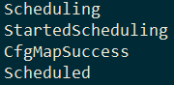
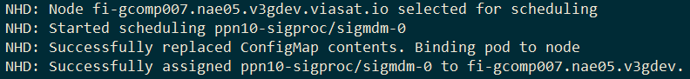
Binding
Best node has been chosen after matching stage
Issues a bind command to Kubernetes API server on pod object
Issues native Kubernetes events viewable from any standard monitoring system

Slide 43
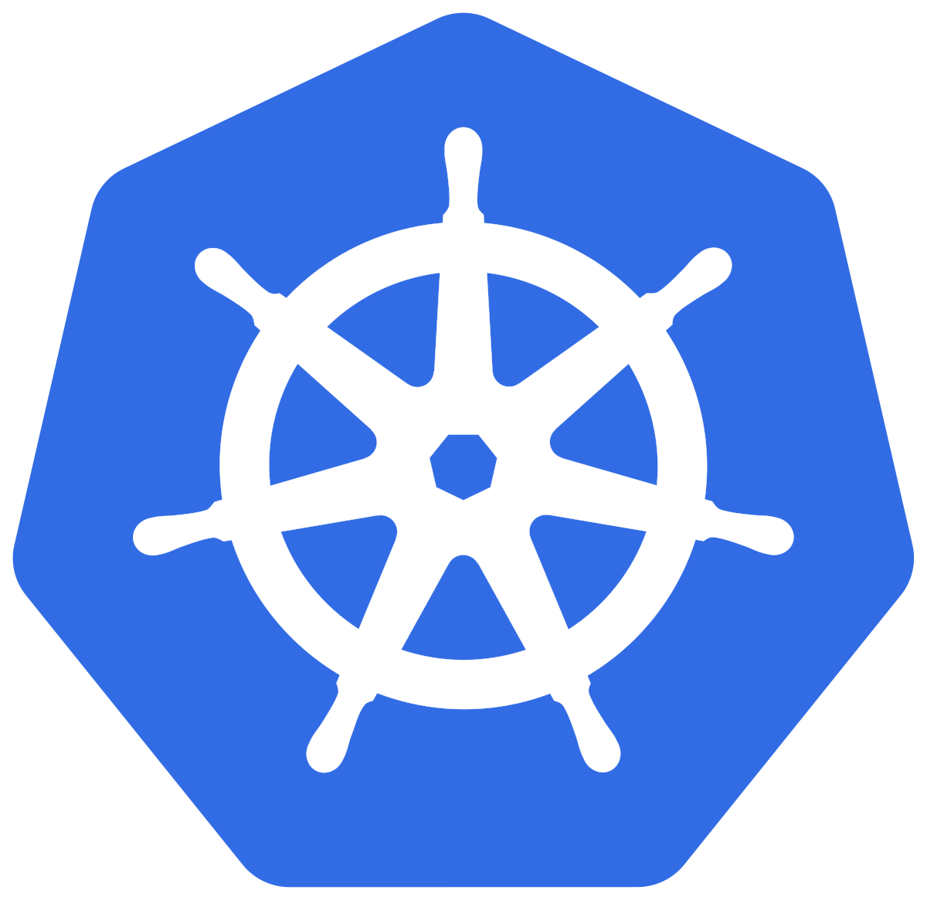
Upstream Topology Manager
First introduced in Kubernetes 1.16 as alpha
Uses topology hints from hint providers to map devices to other resources (CPUs)
Not part of the Kubernetes scheduler
Runs in Kubelet on each node
Adding PCIe/other topologies support soon?

Slide 44

Future NHD Work
Open source
Going through legal currently
https://github.com/Viasat/nhd
Intel’s Resource Directory Technology
Cache/memory bandwidth segregation
Speed improvements
NVLink Topology
Delete project!

Slide 45

Thanks
Viasat
Tim Martin, Federico Calzamiglia + Signal Processing Team
Piotr Siwczak
Intel
RedHat

Slide 46


